Slide 1
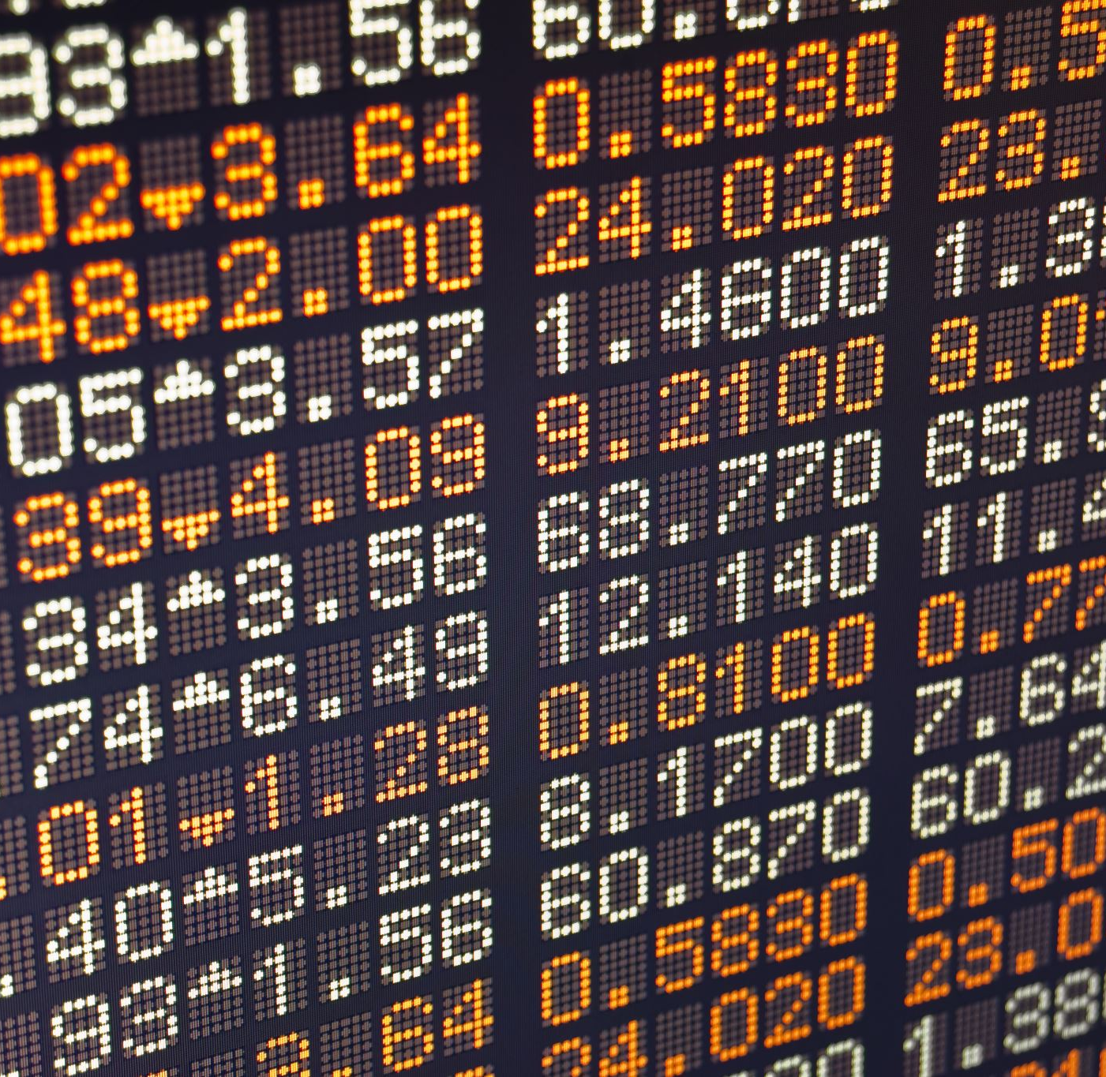
MATRIX - STOCK PRICE PREDICTION
BY
HARSH DESAI
PARASURAM VISWANATH JASTY
POOJITA TADEPALLI

Slide 2
AGENDA
Problem Statement
Solution
Architecture
Machine Learning
Challenges
Data Source

Slide 3
Problem Statement
People want to buy stocks and earn money
Knowing the right time to sell a stock is crucial in making a profit
Different variable are considered in predicting a stock price

Slide 4
SOLUTION
Calculating the risk by investing in a particular stock
Predicting the closing stock price of a company using LSTM

Slide 5
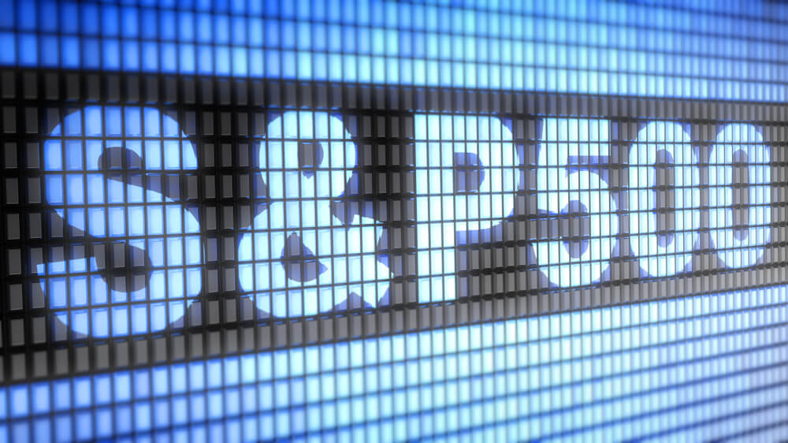
DATA SOURCE
S&P is a stock market index that measures the stock performance of 500 large companies listed on stock exchanges in the United States
It measures capitalization-weighted index
Our dataset contains
Historical stock price data of all the companies found on S&P 500 index
Individual stock ticker historical data (5 years past data) of the companies found on S&P 500 index

Slide 6








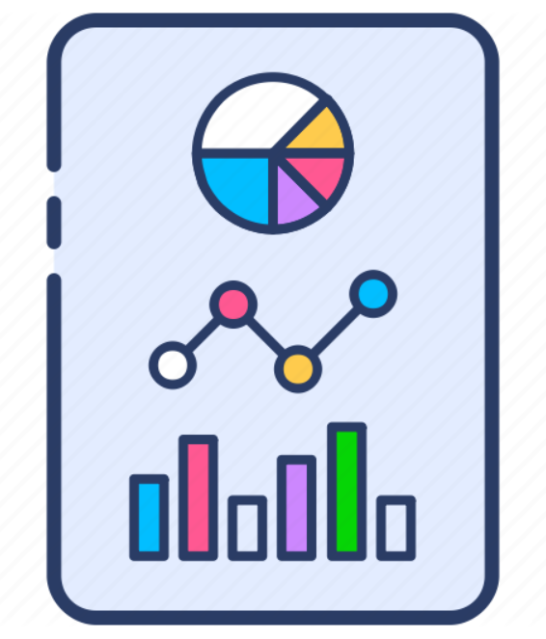
ARCHITECHTURE
LSTM
Time Series
Data cleaning
Data Source - csv
Prediction
ML Algorithms
Jupyter Notebook
Closing price for users
Visualization & Analytics

Slide 7
MACHINE LEARNING
LSTM – It is an artificial recurrent neural network architecture used in the field of deep learning. Unlike standard feedforward neural networks, LSTM has feedback connections. It can not only process single data points, but also entire sequences of data.
Time series Forecasting with Prophet - Facebook's library for time series forecasting.

Slide 8
CHALLENGES
Since trading in done on numerous companies, it was difficult to narrow down to specific ones
Considering variables which will help us to predict closing price of the stock
Data Cleaning

Slide 9

Thank you
Any questions?

